Slide 1


Digital Egypt Pioneers Initiative
Manufacturing
Analysis
Team: 1

Slide 2





Digital Egypt Pioneers Initiative
Mohamed Emad
Menna Younis
Team Members
Mohamed Elsayed
Farah Magdy
Mohamed Abo Bakr

Slide 3
Project Overview
The project addresses key challenges in manufacturing operations by identifying inefficiencies in machine performance. It helps reduce downtime by highlighting underperforming machines and production delays. The analysis optimizes material usage, minimizing waste and lowering costs. It provides visibility into processing time variations across machines. The dashboard supports better decision-making by uncovering bottlenecks in the production process. Overall, it improves productivity, reduces operational costs, and enhances overall manufacturing efficiency.

Slide 4
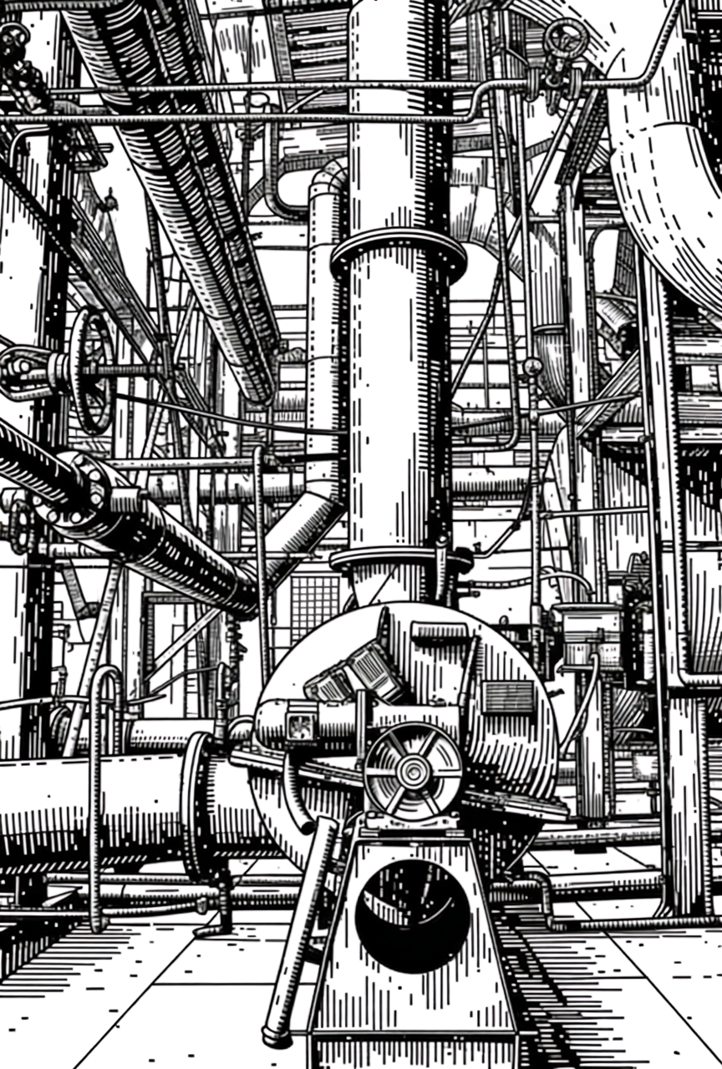
Data Acquisition
1.Administrative Data (Internal):
• Consists of organizational data from the initiative, including production
targets, employee shifts, and resource schedules.
2. Operational Data (External):
•Sourced from Kaggle, consisting of real-time machine performance, sensor readings (temperature/pressure), and actual production output.
• Data Link: https://www.kaggle.com/datasets/ziya07/manufacturing-production-data
3. Method:
• Data was extracted and imported into Power BI using Power Query to integrate internal administrative files with external operational datasets.

Slide 5

Problem Definition
1. Project Objective
• To analyze the alignment between administrative planning and shop-floor operations to identify production bottlenecks and optimize resource utilization.
2. Business Questions
• How does the actual production output compare to the administrative targets?
• What are the main causes of machine downtime or operational delays?
• Which production lines show the highest efficiency and which need maintenance?
3. Key Performance Indicators – KPIs
• OEE (Overall Equipment Effectiveness)
• Production Yield
• Downtime Rate
• Cycle Time
4. Target Audience
• Operations Managers
• Production Supervisors
• Supply Chain & Administrative Planners

Slide 6
Business Question
Labor Productivity
Who are the most and least productive operators?
Which flavors are driving the most production volume?
How much downtime is caused by human error versus technical issues?
Machine Technical Performance
Which machine is the most reliable?
What is the primary cause of equipment downtime?
Are certain machines consuming more raw materials than others?
Quality Control & Optimization
Is our quality improving or declining over time?
Which operation type has the highest failure rate?
Does machine identity correlate with higher errors?
Scheduling & Time Variance
What percentage of our total jobs are currently failing or delayed?
Which operators have the most "Delayed" jobs?
How does our actual production volume compare to what we scheduled?

Slide 7
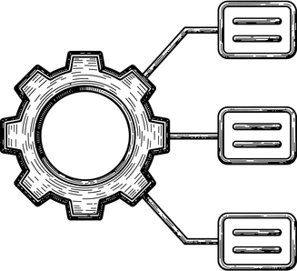

Steps
Data Cleaning is the process of fixing or removing incorrect, corrupted, duplicate, or incomplete data within a dataset to ensure accuracy and improve the quality of analysis
DAX (Data Analysis Expressions) is a formula language used in Power BI and Excel to create custom calculations and perform advanced data analysis through functions and operators.
Dashboard is a visual interface that consolidates and displays key metrics and data visualizations on a single screen to monitor performance and make quick, data-driven decisions.
01 Dataset
02 Data Clean
03 Data Model
04 Daxs
05 Sample Visual
06 Reports
07 Dashboard
A Data Set is a structured collection of related information, typically organized in rows and columns, used for statistical analysis or training machine learning models.
Data Modeling is the process of creating a visual representation or "blueprint" that defines how data is structured, stored, and the relationships between different data elements in a system
Sample Visuals are representative charts or graphs (like Bar, Line, or Pie charts) used to display data patterns, making it easier to identify trends and outliers at a glance.

Slide 8



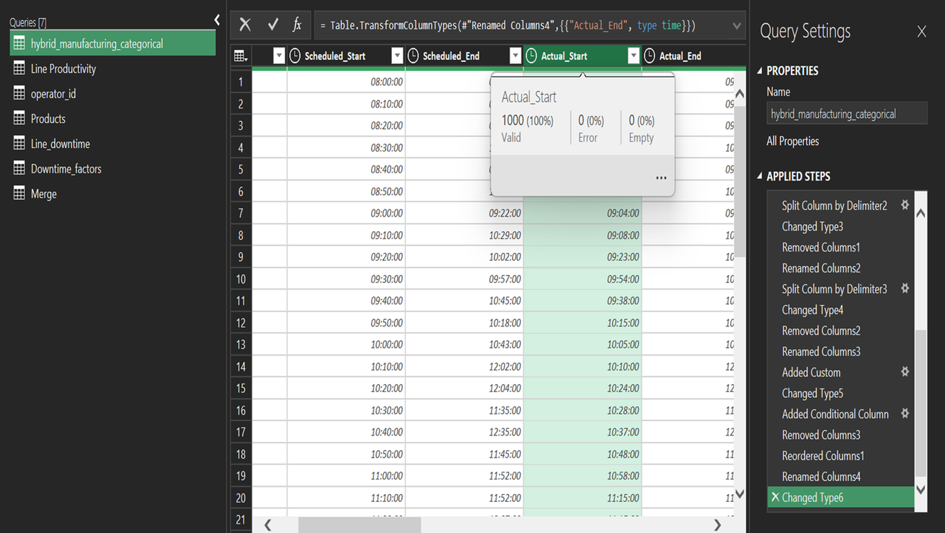
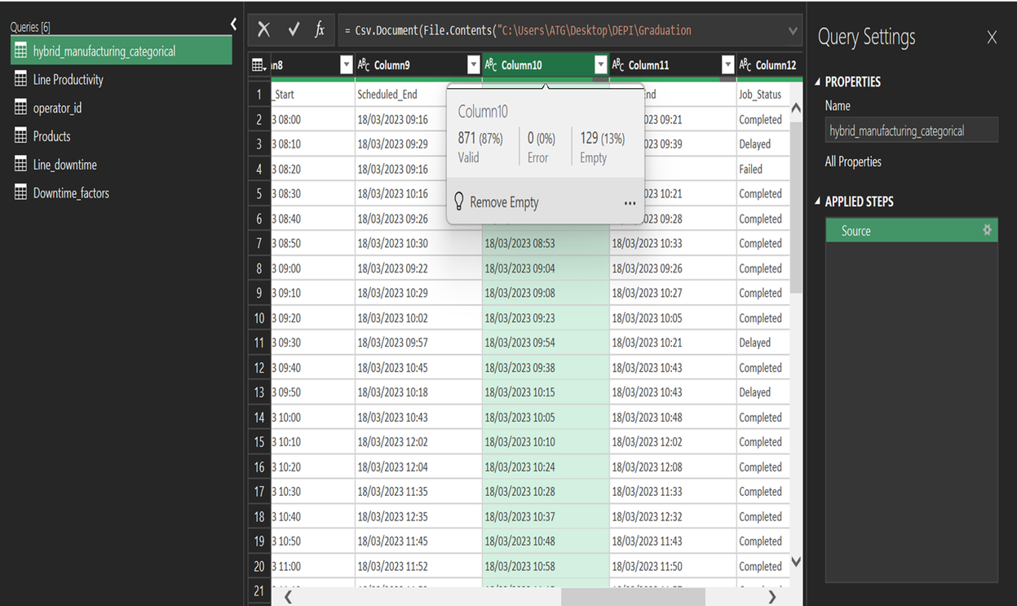
Data Cleaning
01
Before
After
02

Slide 9
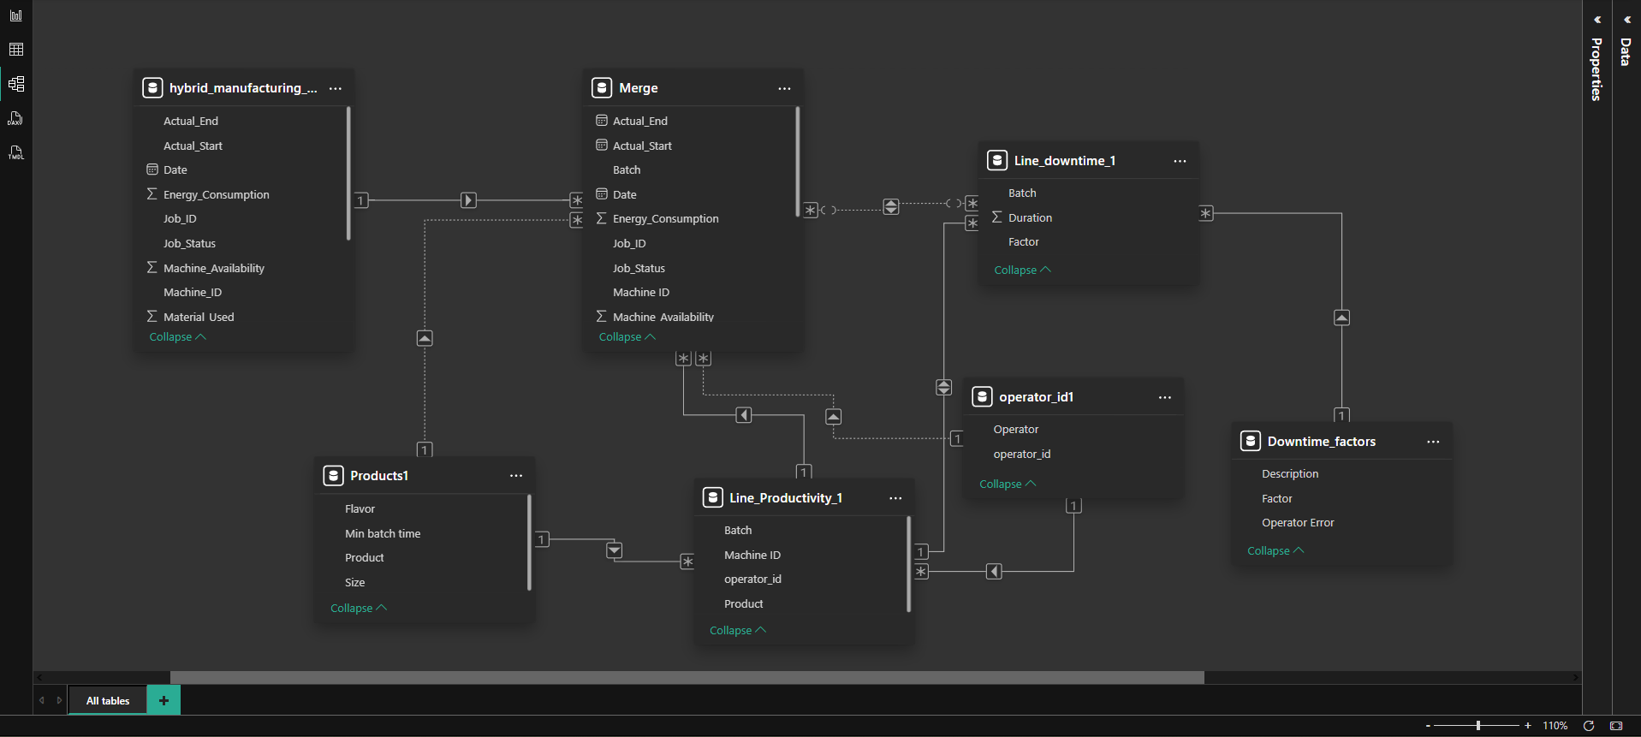
Data Modeling

Slide 10
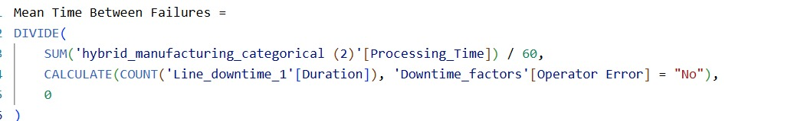
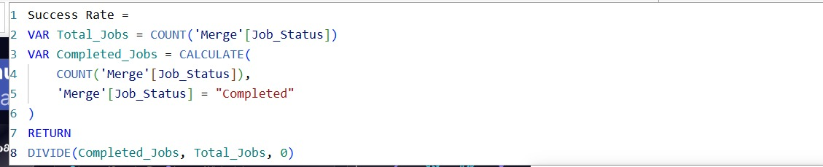
DAX Calculation
Measure Name | DAX Formula | Component Analysis
Mean Time Between Failures
Divide
Sum
Calculate, Count
Divide
Labor Efficiency
Average
Average processing
Average
Calculate, Count
Success Rate
Divide

Slide 11
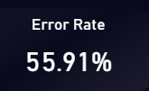
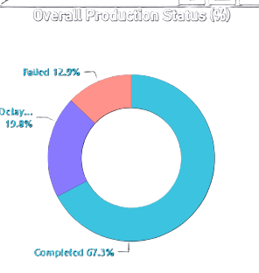
Sample Visual
1. KPI Cards & Gauges: Used to provide an instant "snapshot" of the most critical metrics, such as Total Energy Cost and Success Rate. They help managers spot deviations from targets in seconds.
2. Donut & Pie Charts: Best for showing Part-to-Whole relationships. We use them to visualize the distribution of energy across different operations or to see the breakdown of downtime causes.

Slide 12
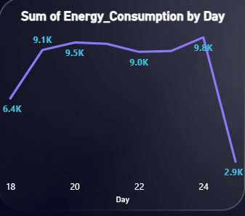
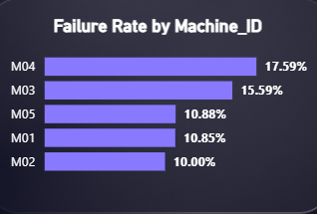

Sample Visual
3. Area & Line Charts: Ideal for tracking Trends over Time. These visuals highlight peak consumption periods and production fluctuations, helping in forecasting and demand planning.
4. Clustered Column & Bar Charts: Used for Comparative Analysis. They allow us to compare performance metrics—like success vs. failure rates—across different machines, shifts, or operators side-by-side.
5. Interactive Slicers & Filters: The core of "Self-Service BI." They enable users to Drill Down into specific data points, such as filtering the entire report for a single Machine ID or a specific production date.

Slide 13
Reports & Dashboard

Slide 14
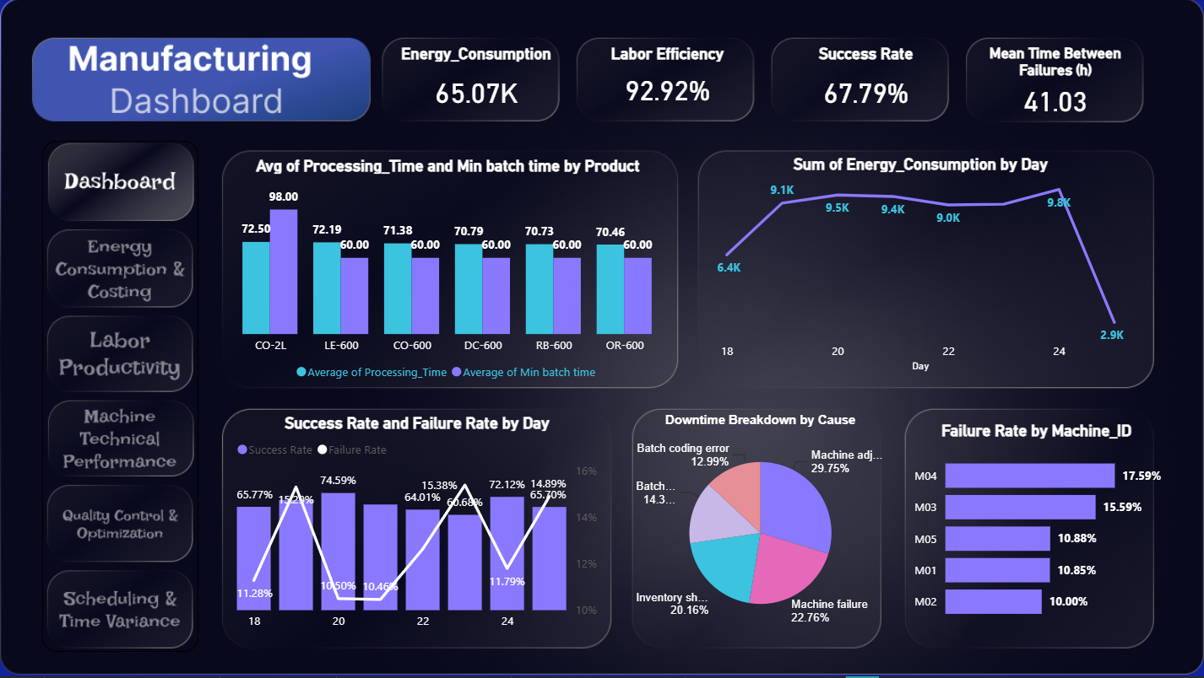

Slide 15
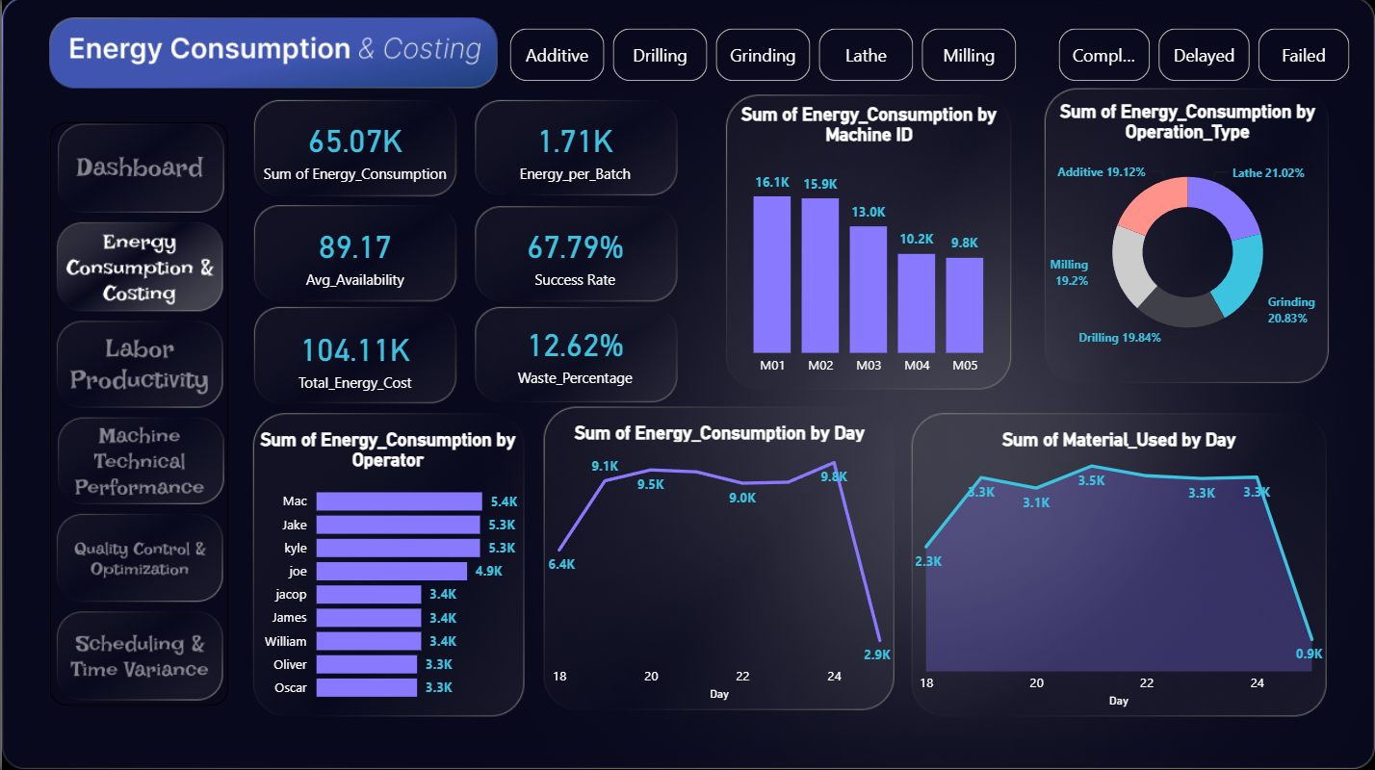

Slide 16
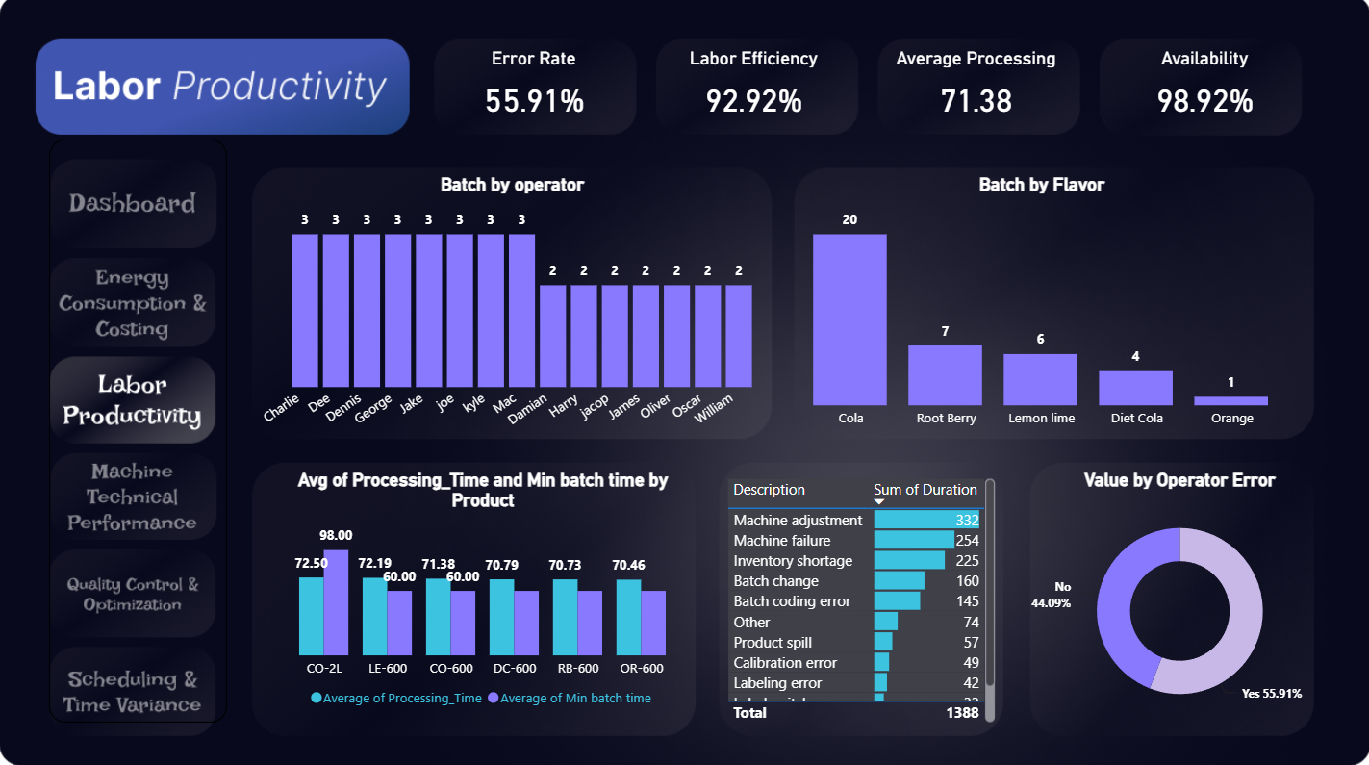

Slide 17
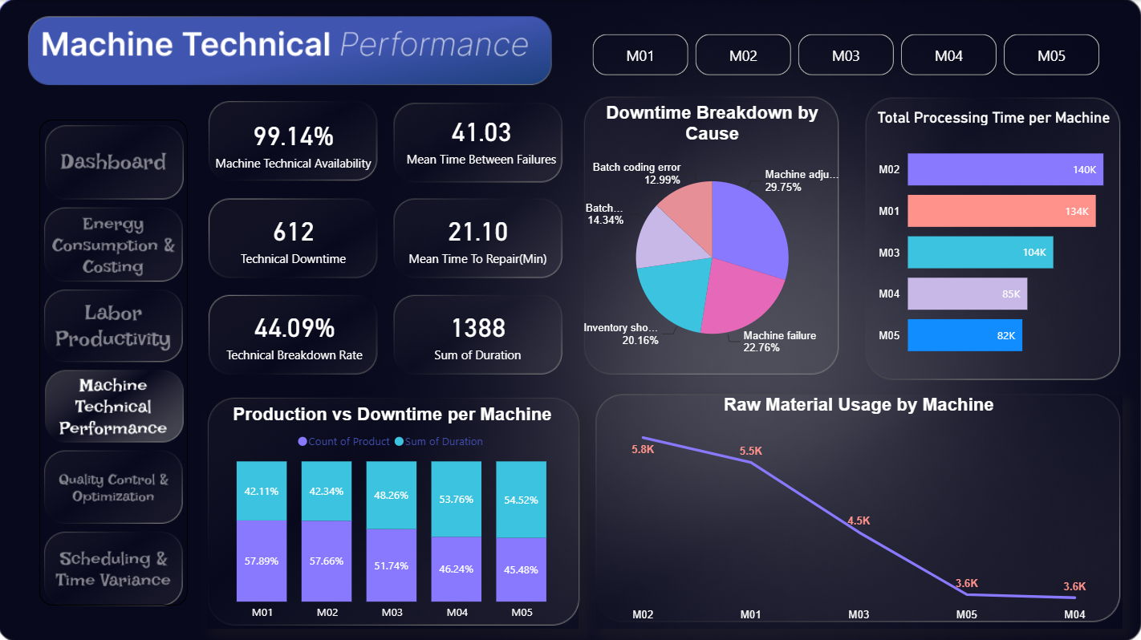

Slide 18
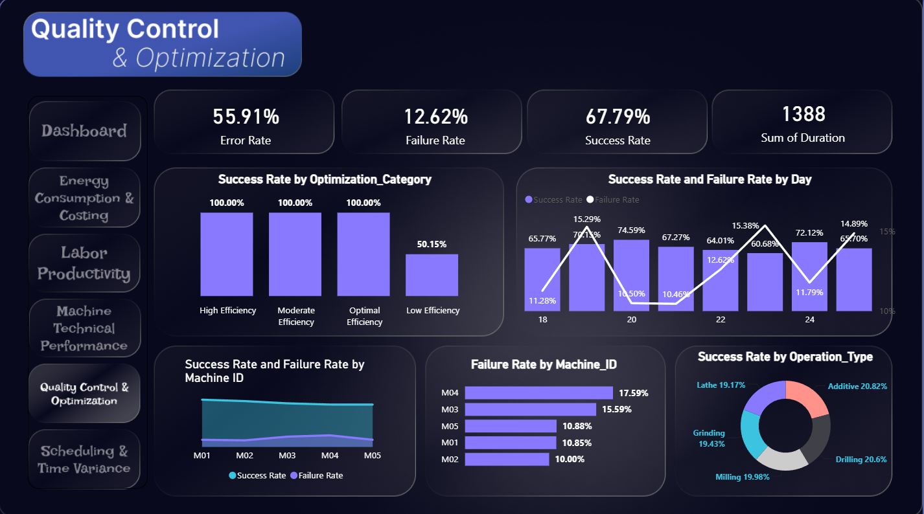

Slide 19
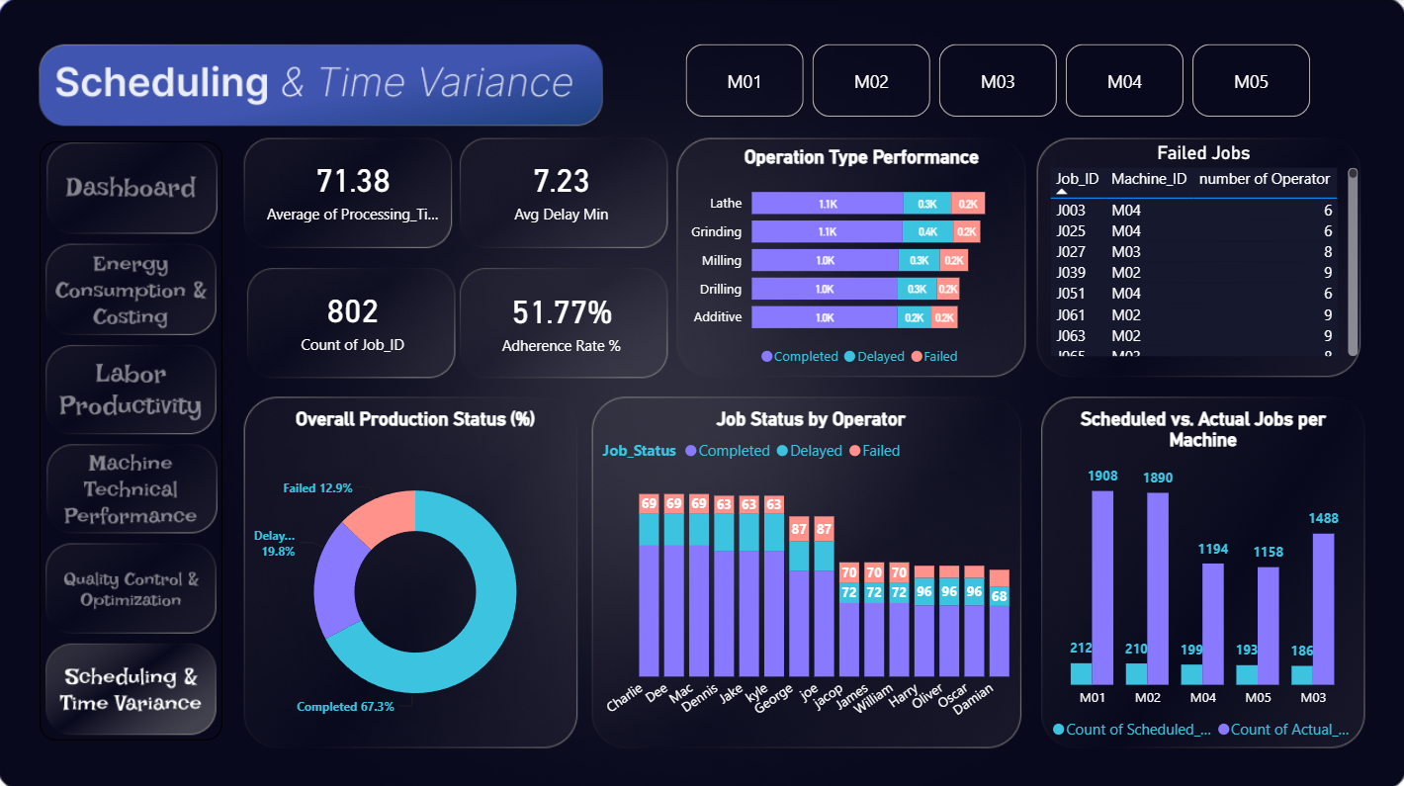

Slide 20
Project Benefits & Strategic Value
1. Data-Driven Decision Making Empowers management to shift from "intuition-based" to "fact-based" decisions by providing real-time visibility into all factory floor operations.
2. Cost Reduction & Resource Optimization Identifies high-energy consumption patterns and wasteful processes, leading to a significant reduction in Operational Expenses (OPEX).
3. Enhanced Asset Utilization Maximizes machine uptime by analyzing downtime root causes and improving maintenance schedules through MTBF and MTTR metrics.
4. Quality & Waste Management Minimizes production failures by correlating success rates with specific machines and operators, ensuring a higher standard of Quality Control (QC).
5. Operational Transparency Creates a "Single Source of Truth" where financial, technical, and labor data are integrated, eliminating communication gaps between departments.

Slide 21
Digital Egypt Pioneers Initiative
Thank You

